Slide 1

Sentiment Analysis of Social Media Presence
By Shaik Amaan
Raavi Deepak
Santhosh sai raj

Slide 2

Outline
01
02
03
Background
Objectives
Methodology
Understanding sentiment analysis and its relevance to social media
Defining the aims and goals of this research project
Exploring the approaches and techniques employed
04
05
Limitations
Conclusion
Acknowledging constraints and potential challenges
Summarising findings and implications

Slide 3

Background
What is Sentiment Analysis?
Sentiment analysis is a method used to understand the emotion behind written text — whether it feels positive, negative, or neutral. With millions of posts being uploaded every day, manually analysing emotions is impossible. That’s why automated sentiment analysis helps us quickly understand what people feel, think, and discuss on social media.
Social media platforms like Twitter, Instagram, and others generate real-time opinions, trends, and reactions. This constant flow of content makes social media an important source for studying public sentiment

Slide 4
Why Social Media Matters
4.8B
500M
95M
Active Social Media Users
Daily Tweets
Instagram Posts Per Day
Means more than half of the world is online sharing their thoughts and opinions.
giving us a constant flow of real-time opinions.
These posts are mostly visual, it becomes a bit more challenging to understand the emotion behind them.
Social media has completely changed the way people talk, share their experiences, and interact with brands. This massive daily conversation brings both new opportunities and new challenges when it comes to understanding public sentiment

Slide 5




Objectives
Understand Public Sentiment
Track How Opinions Change
Find out what people really feel by studying emotions expressed in social media posts across different platforms.
Identify shifts and patterns in public opinion over time for specific topics, brands, or trends..
Compare Different Methods
Turn Data Into Useful Insights
Try out different machine learning techniques to see which one gives the best results for analyzing social media text.
Convert raw sentiment data into clear, meaningful insights that help people make better decisions.

Slide 6





Methodology & Approach
Collecting Data
Gathered social media posts using APIs and web-scraping, focusing on the right keywords and hashtags.
Preprocessing
Cleaned the text by removing URLs, emojis, and unwanted characters, and standardized everything
Model Training
Trained the model using algorithms like Naive Bayes, SVM, and neural networks to classify sentiment
Validation
Checked the model’s accuracy using benchmark datasets and manual review.

Slide 7
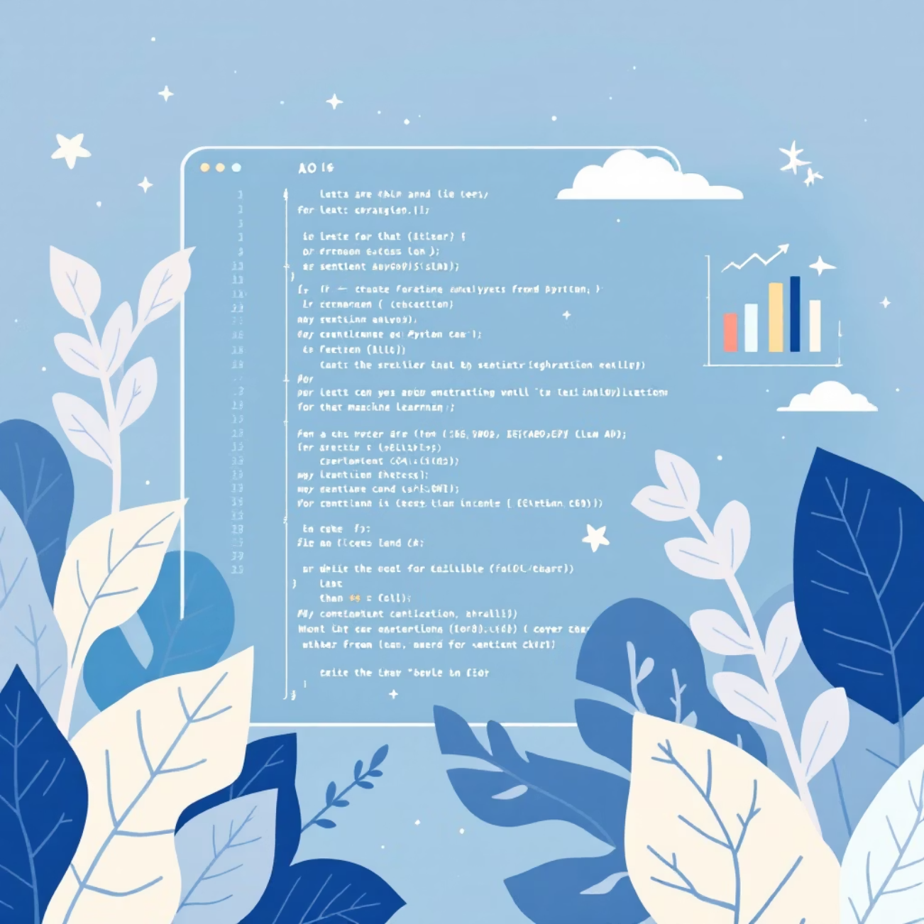
Technical Approach
Key Techniques Employed
Natural Language Processing: First, we broke down the text properly — tokenizing, stemming, lemmatizing — basically cleaning it so the system understands what’s what.
Feature Extraction: Then we converted the text into numbers using TF-IDF and word embeddings. Without this step, the model is basically blind.
Machine Learning Models: We trained supervised models with labelled examples so the system actually learns how to judge sentiment.
Deep Learning: For deeper understanding, we used LSTMs — these help the model catch context, not just words
In simple terms, we mixed old-school NLP tricks with modern deep learning so the analysis works smoothly across all kinds of social media content.

Slide 8
Caveats & Limitations
Sarcasm and Irony
Context Dependency
Multilingual Challenges
Sarcastic lines are tough to catch because what people say and what they actually mean are opposite. So the model can get confused and give the wrong sentiment..
Some words change meaning based on how they’re used. Like “sick” can mean awesome or terrible. The model needs deeper context to understand this properly..
Social media is full of mixed languages — English + Hindi, Tamil + English, Telugu slang, etc. Models trained on just one language often fail when people switch between them.
Emoji Interpretation
Data Bias
Emojis look simple but carry different meanings based on culture and situation. That makes them hard for the system to interpret correctly.
If the training data itself is biased (like more posts from one age group or region), the results also get biased. This can tilt the sentiment analysis unfairly.

Slide 9

Conclusion
Sentiment analysis helps us quickly understand what people feel on social media and gives clear insights into public opinion. It works well with machine learning and deep learning but still faces challenges like sarcasm, mixed languages, and context. With better models in the future, it can become even more accurate and useful for brands, businesses, and researchers.

Slide 10

References & Acknowledgment
Liu, B. Sentiment Analysis and Opinion Mining, Morgan & Claypool Publishers, 2012.
Pang, B., & Lee, L. "Opinion Mining and Sentiment Analysis", Foundations and Trends in Information Retrieval, 2008.
Sentiment Analysis Basics.” Towards Data Science
Natural Language Processing (NLP) Guide.” Analytics Vidhya.
Acknowledgment
I want to express my sincere gratitude to my faculty and department for allowing me to work on this project. I am thankful to my guide for their support and guidance throughout the preparation of this report. I also appreciate the encouragement from my friends and family, which helped me complete this project successfully

